Slide 1
TOWARDS TOTAL RECALL IN INDUSTRIAL ANOMALY DETECTION
Karsten Roth, Latha Pemula, Joaquin Zepeda, Bernhard Scholkopf, Thomax Brox, Peter Gehler
Computer Vision and Pattern Recognition 2022
Damiano Ferla
Advanced Machine Learning – 2022/2023

Slide 2
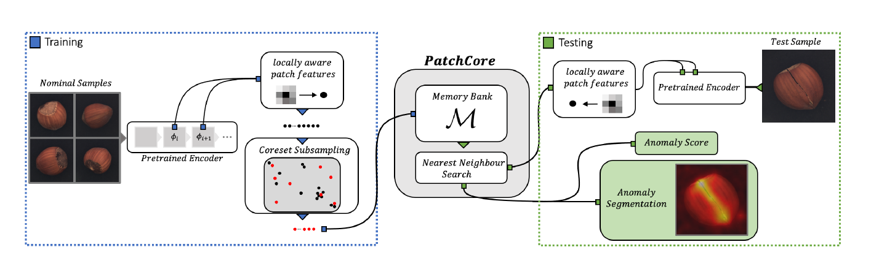

Background: the cold-start problem
Past works:
SPADE
PaDiM
…
Proposed Solution: PatchCore
2

Slide 3

Method: Local patch feature aggregated into a memory bank (I)
PatchCore uses a pre-trained network ϕ
Features representation: last level in the hierarchy or memory bank?
3

Slide 4
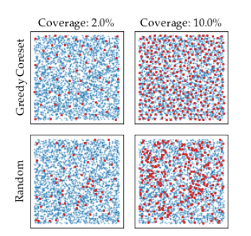

Method: Core-set subsampling (II)
Random subsampling or Core-set subsampling?
But the computation of the approximated memory bank is complex…
4

Slide 5

Method: Anomaly Detection (III)
Anomaly score s = maximum score of distance s* between test patch-features and each nn m* associated to it.
5

Slide 6
Experiments: Evaluation Metrics (I)
Metrics: Area under the receiver-operator curve (AUROC); AUROC PRO.
Anomaly Detection on MVTec AD
Inference time
6

Slide 7
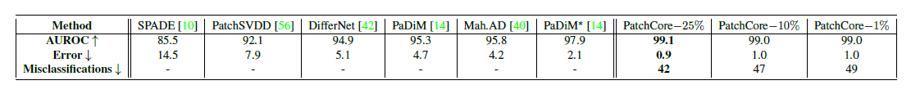








Experiments: Anomaly Detection on MVTec AD (II)
Anomaly Detection Performance on MVTec AD
Anomaly Segmentation Performance on MVTec AD
7

Slide 8
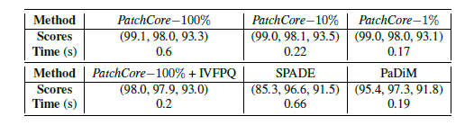
Experiments: Inference Time (III)
Inference time of PatchCore-100% is lower than SPADE, but with better performance
With core-set subsampling, PatchCore could be faster, with inference time lower than PaDiM
IVFPQ: Inverted File Index combined with Product Quantization
8

Slide 9
Conclusions
+ State-of-the-art perfomance about the cold-start anomaly detection problem
+ Successful application in the industrial domain
Not much improvement in other domains (actually)
Applicability problem
9

Slide 10
References:
TOWARDS TOTAL RECALL IN INDUSTRIAL ANOMALY DETECTION

Slide 11
THANKS FOR YOUR
ATTENTION!
Damiano Ferla
Advanced Machine Learning – 2022/2023

